Slide 1

Geometry
Unit 1, Lesson 8 Line Segments Volume 1, pg. 53

Slide 2


Benchmarks
MA.912.GR.1.1
Prove relationships and theorems about lines and angles. Solve mathematical and real-world problems involving postulates, relationships, and theorems of lines and angles.
MA.912.GR.5.1
Construct a copy of a segment or an angle.
volume 1, pg. 53

Slide 3
Integrated Mathematical Thinking and Reasoning Standards
MA.K12.MTR.2.1 Demonstrate understanding by representing problems in multiple ways.
MA.K12.MTR.4.1 Engage in discussions that reflect on the mathematical thinking of self and others.
MA.K12.MTR.5.1 Use patterns and structure to help understand and connect mathematical concepts.
MA.K12.MTR.6.1 Assess the reasonableness of solutions.
volume 1, pg. 53

Slide 4

Learning Targets
I can construct a copy of a line segment.
I can use the segment addition postulate.
volume 1, pg. 53

Slide 5

Warm-Up
volume 1, pg. 53

Slide 6
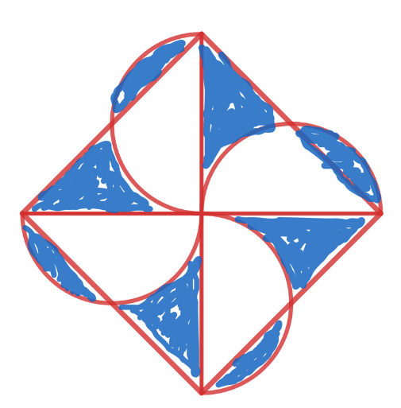
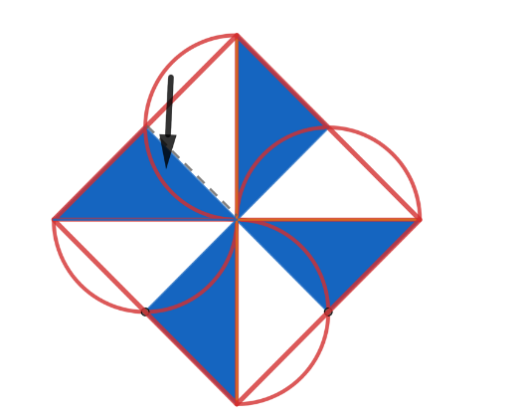
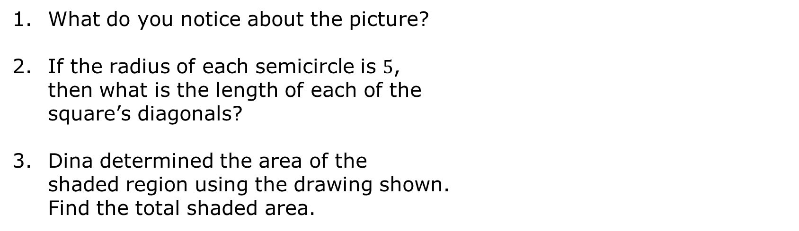
1.8.1 Warm-Up: Semicircles and Triangles
What do you notice about the picture?
If the radius of each semicircle is $5$, then what is the length of each of the square’s diagonals?
Dina determined the area of the shaded region using the drawing shown. Find the total shaded area.
volume 1, pg. 53

Slide 7

Guided Instruction
volume 1, pg. 54

Slide 8


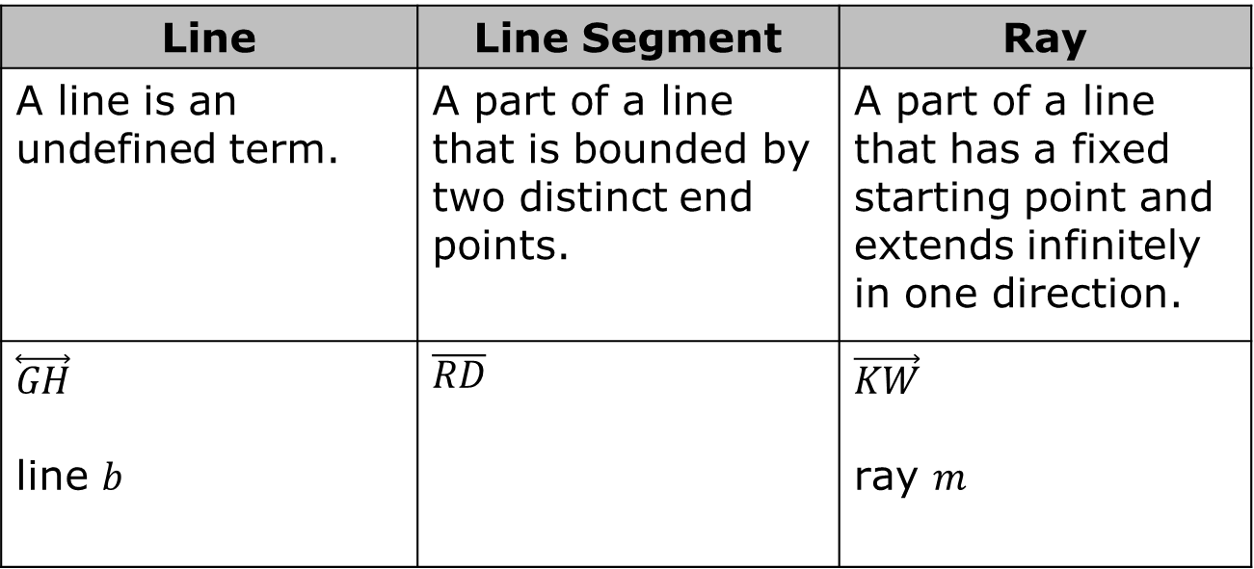



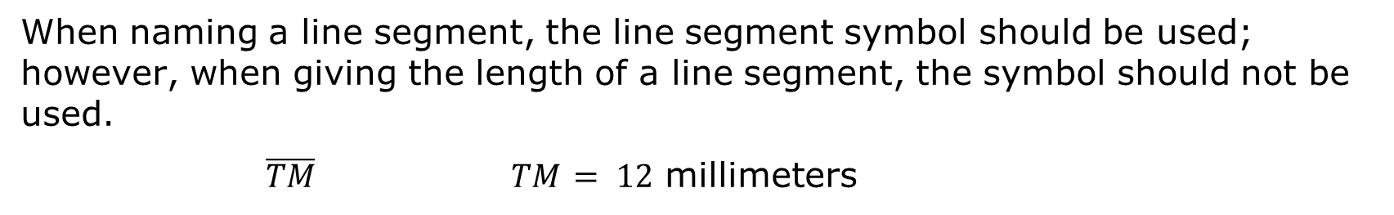



1.8.2 Guided Instruction: Line Segments
Line | Line Segment | Ray
A line is an undefined term. | A part of a line that is bounded by two distinct end points. | A part of a line that has a fixed starting point and extends infinitely in one direction.
$$\overset{⃡}{GH}$$ line $b$ | $$\overline{RD}$$ | $$\vec{KW}$$ ray $m$
$$G$$
$$H$$
$$R$$
$$D$$
$$K$$
$$W$$
$$b$$
$$m$$
When naming a line segment, the line segment symbol should be used; however, when giving the length of a line segment, the symbol should not be used.
$\overline{TM}$ $TM$ $= 12$ millimeters
volume 1, pg. 54

Slide 9
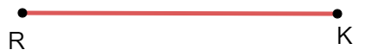
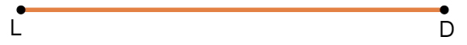
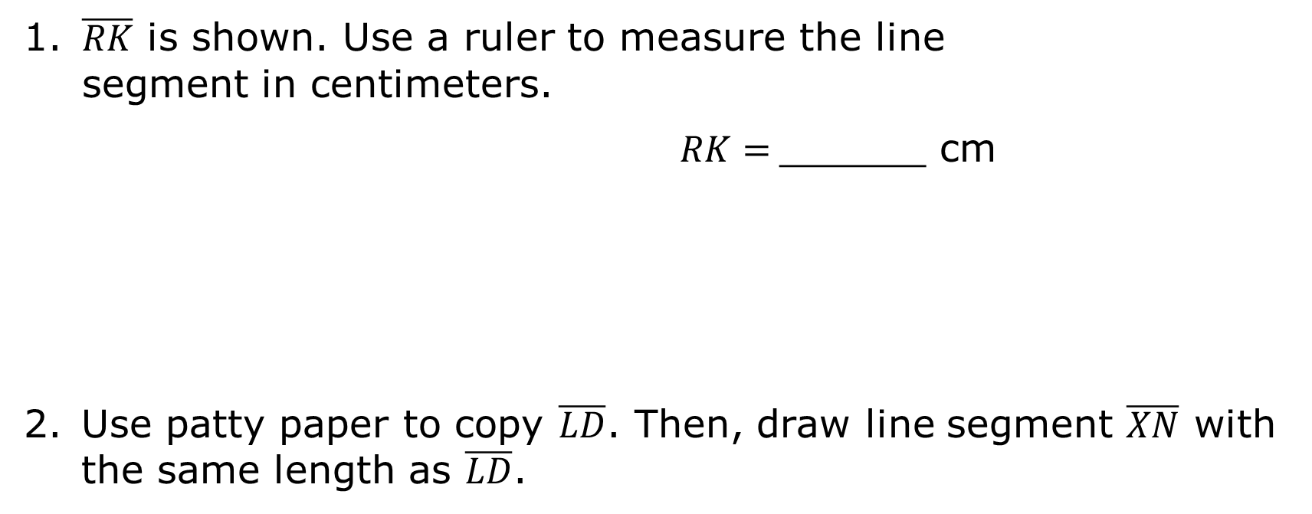
$\overline{RK}$ is shown. Use a ruler to measure the line segment in centimeters.
$RK=$______ cm
Use patty paper to copy $\overline{LD}$. Then, draw line segment $\overline{XN}$ with the same length as $\overline{LD}$.
volume 1, pg. 54

Slide 10
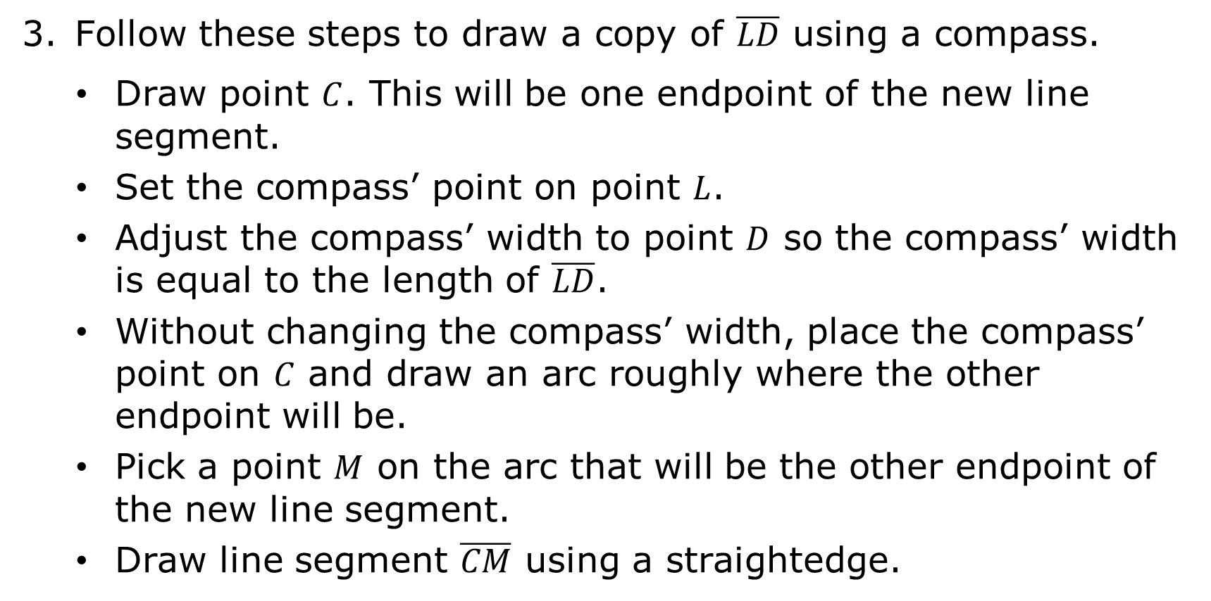
Follow these steps to draw a copy of $\overline{LD}$ using a compass.
Draw point $C$. This will be one endpoint of the new line segment.
Set the compass’ point on point $L$.
Adjust the compass’ width to point $D$ so the compass’ width is equal to the length of $\overline{LD}$.
Without changing the compass’ width, place the compass’ point on $C$ and draw an arc roughly where the other endpoint will be.
Pick a point $M$ on the arc that will be the other endpoint of the new line segment.
Draw line segment $\overline{CM}$ using a straightedge.
volume 1, pg. 54

Slide 11
Discuss with your partner how to show that the two toothpicks are congruent using each method in the table. Then, write a brief explanation for each method.
Transformation
Patty Paper
Compass
volume 1, pg. 55

Slide 12

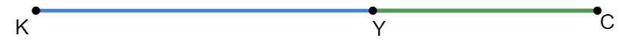
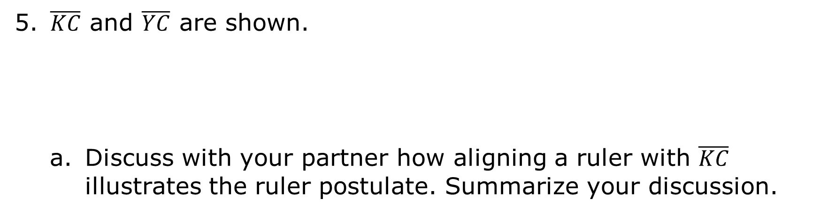
Ruler Postulate
The points of a line can be placed in a one-to-one correspondence with the real numbers such that the distance between two distinct points is the absolute value of the difference of the corresponding real numbers.
$\overline{KC}$ and $\overline{YC}$ are shown.
Discuss with your partner how aligning a ruler with $\overline{KC}$ illustrates the ruler postulate. Summarize your discussion.
volume 1, pg. 55

Slide 13
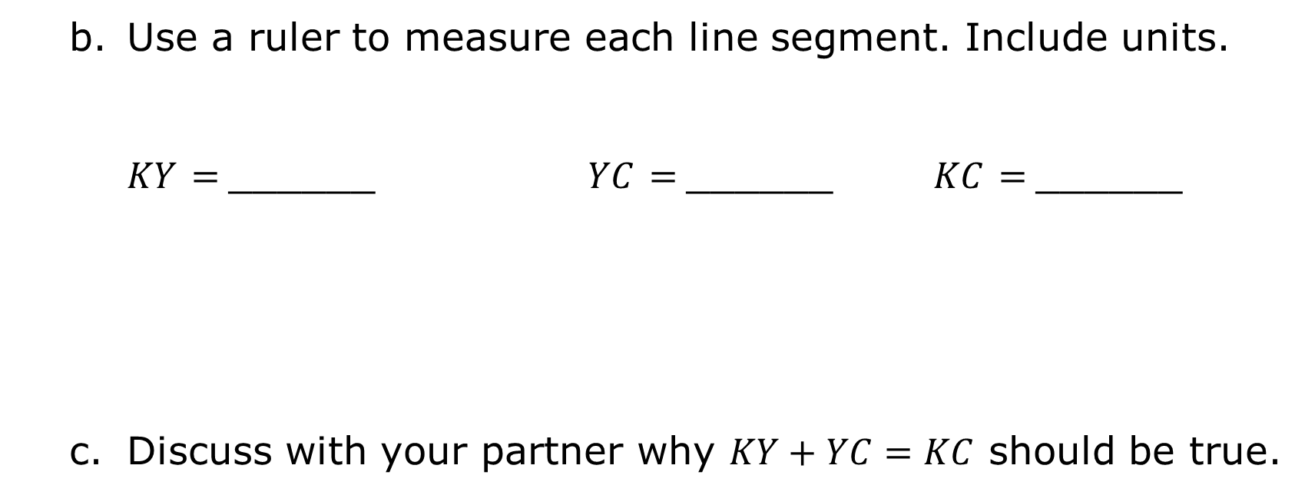
Use a ruler to measure each line segment. Include units.
$KY$ $=$______ $YC$ $=$______ $KC$ $=$______
Discuss with your partner why $KY+YC=KC$ should be true.
volume 1, pg. 55

Slide 14

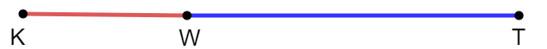
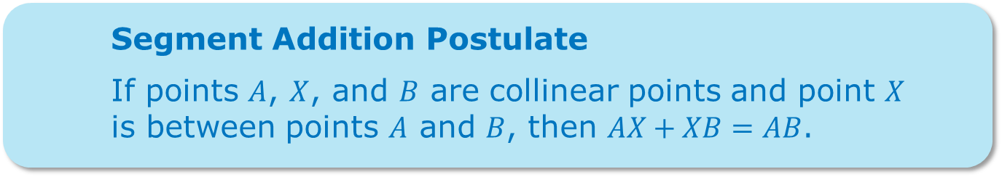
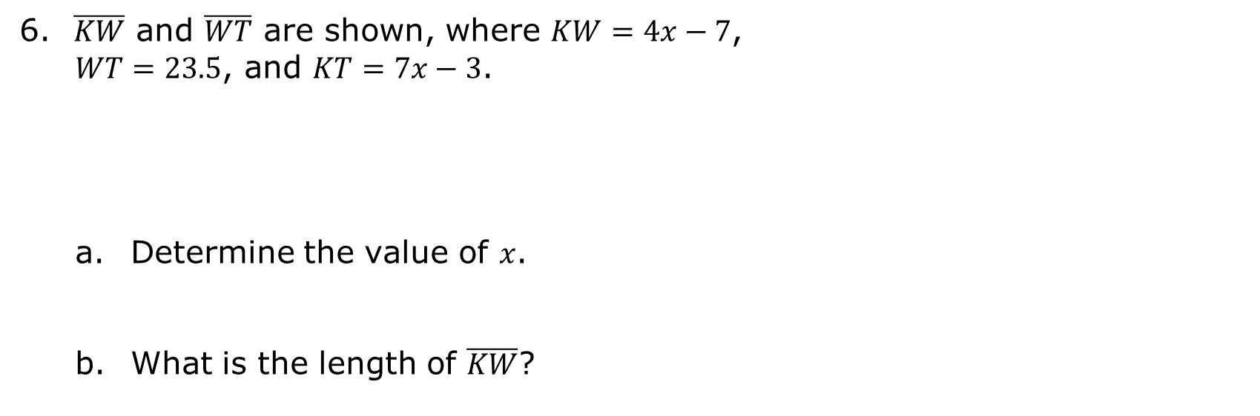
Points on the same line are called collinear points.
Segment Addition Postulate
If points $A$, $X$, and $B$ are collinear points and point $X$ is between points $A$ and $B$, then $AX+XB=AB$.
$\overline{KW}$ and $\overline{WT}$ are shown, where $KW=4x−7$,
$WT=23.5$, and $KT=7x−3$.
Determine the value of $x$.
What is the length of $\overline{KW}$?
volume 1, pg. 56

Slide 15

Guided Practice
volume 1, pg. 56

Slide 16


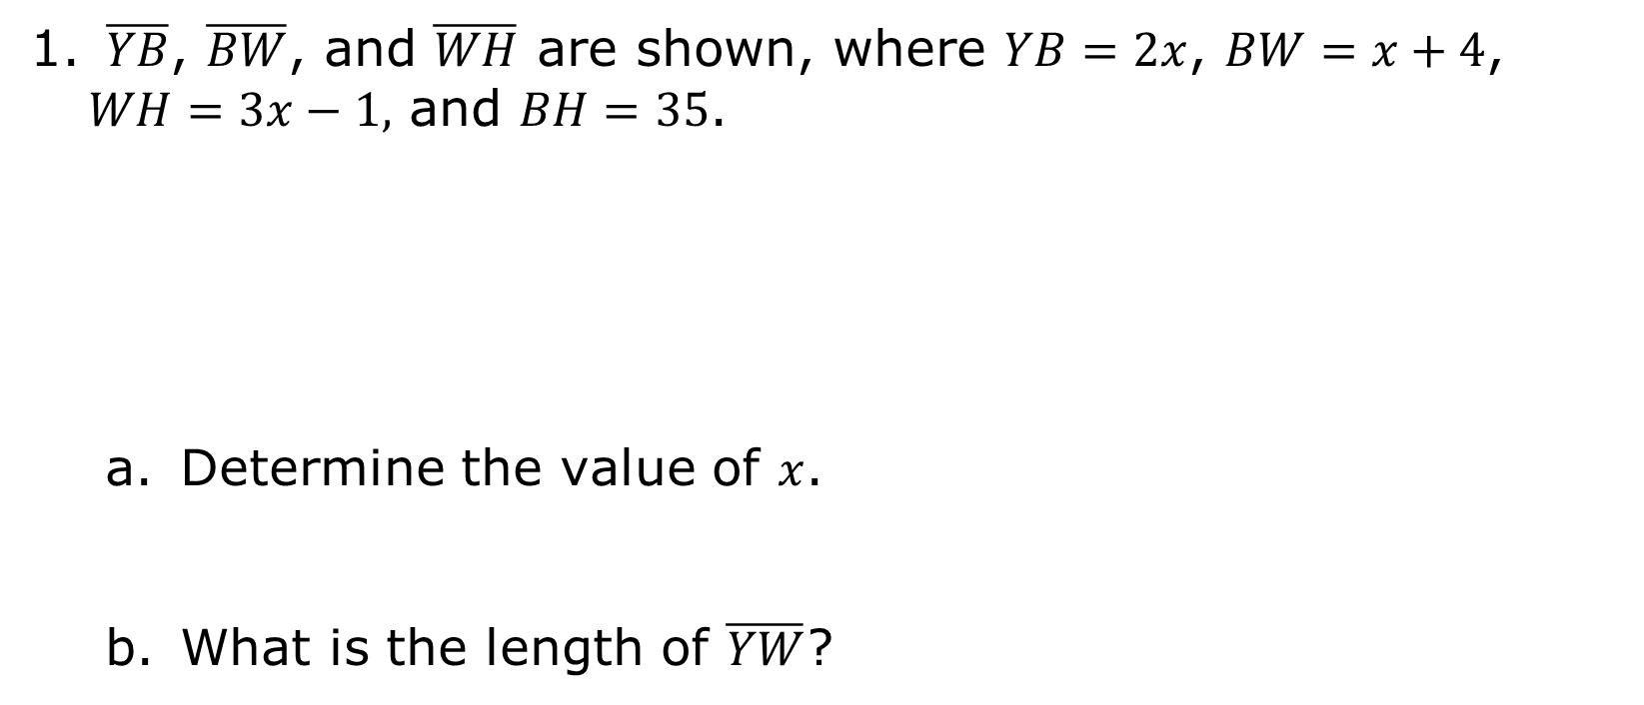
1.8.3 Guided Practice: Segment Addition
$\overline{YB}$, $\overline{BW}$, and $\overline{WH}$ are shown, where $YB=2x$, $BW=x+4$, $WH=3x−1,$ and $BH=35$.
Determine the value of $x$.
What is the length of $\overline{YW}$?
volume 1, pg. 56

Slide 17
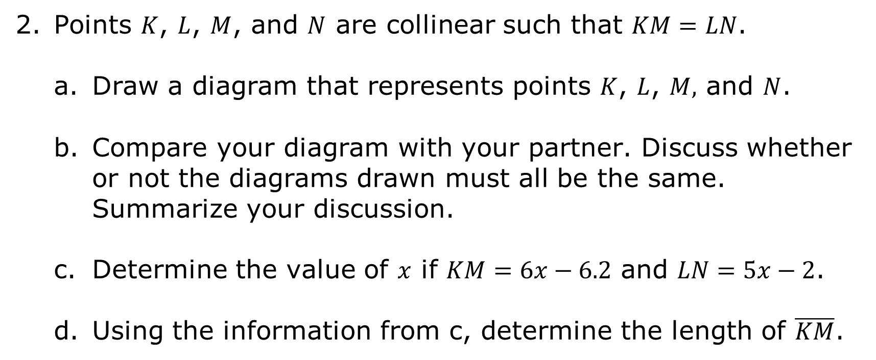
Points $K$, $L$, $M$, and $N$ are collinear such that $KM=LN$.
Draw a diagram that represents points $K$, $L$, $M,$ and $N$.
Compare your diagram with your partner. Discuss whether or not the diagrams drawn must all be the same. Summarize your discussion.
Determine the value of $x$ if $KM=6x−6.2$ and $LN=5x−2$.
Using the information from c, determine the length of $\overline{KM}$.
volume 1, pg. 56

Slide 18

Try It
volume 1, pg. 57

Slide 19

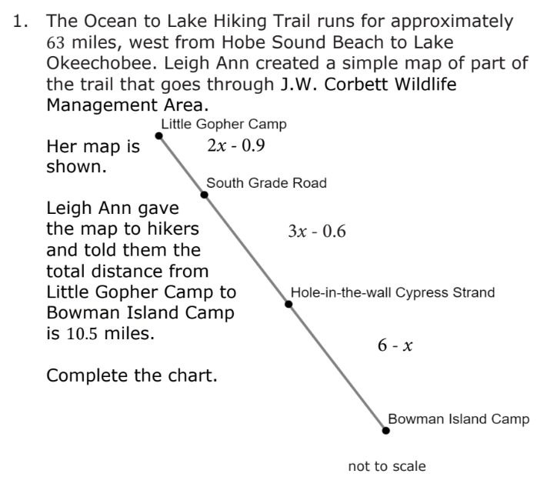
1.8.4 Try It: Ocean to Lake Florida Trail
volume 1, pg. 57

Slide 20
Complete the chart.
Hike | Distance (miles)
Little Gopher Camp to South Grade Road
South Grade Road to Hole-in-the-wall Cypress Strand
Hole-in-the-wall Cypress Strand to Bowman Island Camp
volume 1, pg. 57

Slide 21

Wrap-Up
volume 1, pg. 58

Slide 22
1.8.5 Wrap-Up: Cool Down
Create an example of the segment Addition Postulate and show the steps to finding the total length.
volume 1, pg. 58

